Slide 1
Difference between classification and regression
Notes:
The name of the section would be mentioned here.

Slide 2
In this Section, we are going to take a look at…
What is Classification
What is Regression

Slide 3
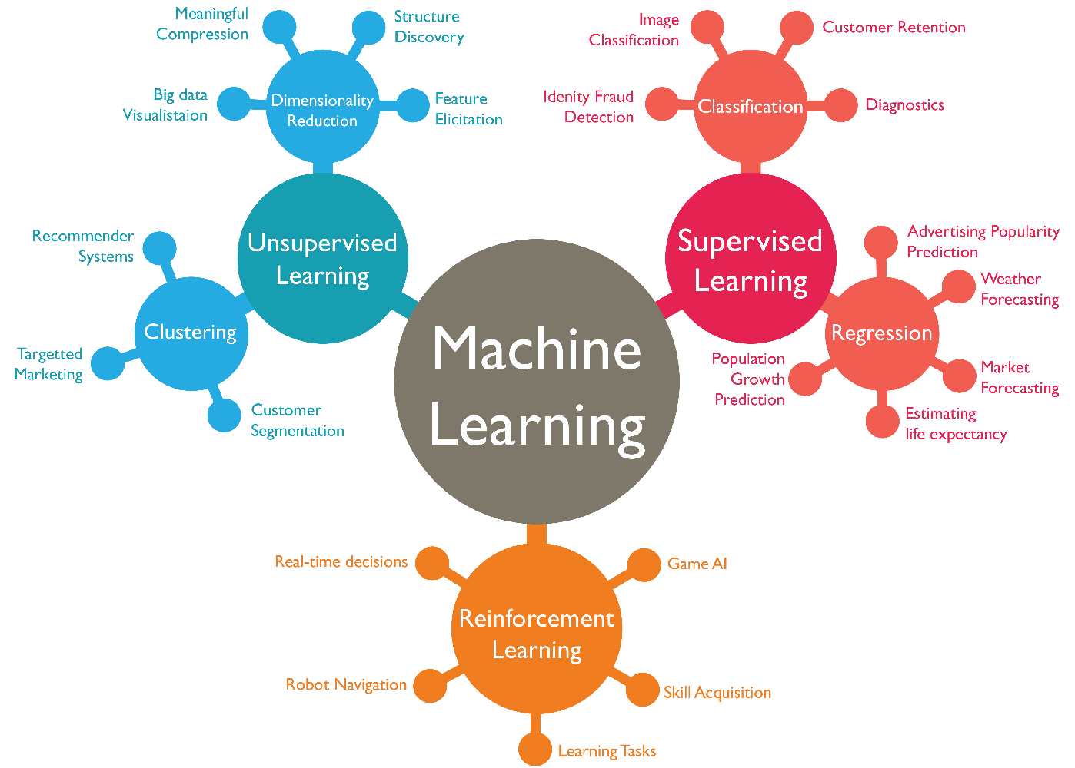

Slide 4
Next Video
Installing JDK and JRE
Notes:
[Mandatory Slide]
Here the name of the next video needs to be mentioned. The narration as you guessed it would be just letting the viewer know exactly where we are at and what we’d be taking over next! ☺

